Slide 1
Recommender Systems
Machine Learning in Recommender Systems
Adoption of Machine Learning in Recommender Systems
Content Based Filtering with Machine Learning
Collaborative Filtering with Machine Learning
Shahzaib Hamid

Slide 2
Overview
Machine Learning in Recommender Systems
Benefits of Machine Learning in Recommender Systems
Design Approaches for Recommender Systems using Machine Learning
Guidelines for Machine Learning based Recommender Systems
Content Based Filtering using Machine Learning
Item based Collaborative Filtering using Machine Learning
User based Collaborative Filtering using Machine Learning

Slide 3
Machine Learning in Recommender Systems
These are powerful engines
Deploys machine learning algorithms for customer segmentations
Identifies customer behavioral patterns
Target customers with personalized products
Behavioral
Purchase patterns
Usage rate
Loyalty status
Demographic
Age
Income
Gender
Psychographic
Personality
Life Style
Interests
Geographic
Region
City Size
Climate

Slide 4
Benefits of Machine Learning in Recommender Systems
Better User Experience
Focus on the Right Product
Sales Drive
Data-Driven Decision Making
Revenue Growth

Slide 5
Guidelines for Machine Learning based Recommender Systems
Approaches
User-driven strategies
Page context-driven strategies
Ready-made solutions
Business Scenario
Targeted Audience
Product Range
New User
Regular User
Identify Customer Journey
Most Popular Products
Similar Products
Bought Together
Evergage
Adobe Target
IBM Watson Real-Time Personalization

Slide 6
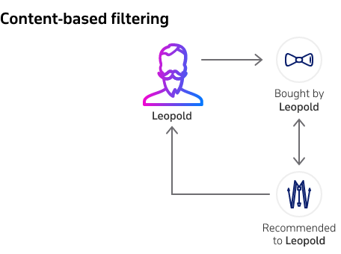
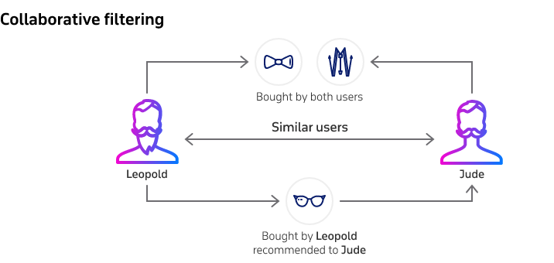
Design Approaches for Recommender Systems using Machine Learning

Slide 7
Content based Filtering with Machine Learning
Steps to make a machine learning based content based recommendation systems
Data Preparation
Data Insights
Implement Time Frequency and Inverse Document Frequency
Build the Recommendation Engine
Test Recommender System

Slide 8
Item-based Collaborative Filtering
Steps to make a machine learning based content based recommendation systems
Data Preparation
Data Insights
Implement k-Nearest Neighbors
Build the Recommendation Engine
Test Recommender System

Slide 9
User-based Collaborative Filtering
Steps to make a machine learning based content based recommendation systems
Data Preparation
Data Insights
Implement Surprise for CoClustering, baseline and Normal Predictor
Build the Recommendation Engine
Test Recommender System

